Slide 1

West Nile Virus Prediction
By: Ohoud, Esraa, Nada, Bushra

Slide 2
Outline
Problem Statement
Data Exploration / Feature Selection
Processing Data
Model Building
interpreting

Slide 3
Problem statement
Given weather, location, testing, and spraying data, we are going to predict when and where different species of mosquitos will test positive for West Nile virus.

Slide 4
Data
Traps information data
Weather data
Spray data

Slide 5
Processing Data
Merging data: main data+ weather data
Drop unnecessary columns : Address, Latitude, Longitude .. etc
Fill missing values ‘M’ with forward fill technique : Sunrise, Sunset, StnPressure, SnowFall
Feature engineering: Sperate Date column to year, month, day

Slide 6
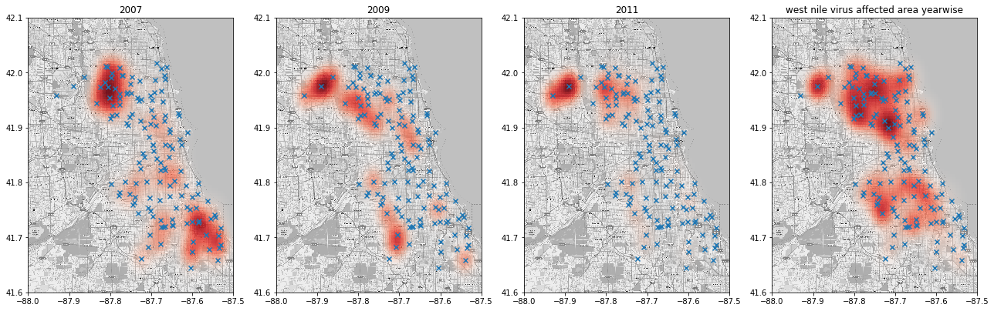
Traps information data

Slide 7
Model building
Data
XG Boost Model
eXtreme Gradient Boosting
West Nile Probability

Slide 8

Kaggle Score :
0.74303

Slide 9
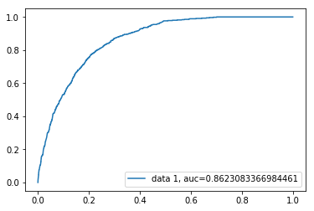
ROC

Slide 10
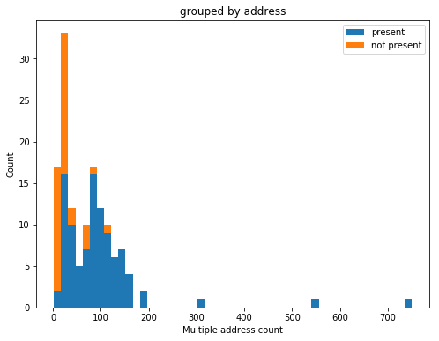
interpreting

Slide 11
Questions ?

